Slide 1
ENSE 470, Milestone 4
Team DCC
Dakota Fisher, Chengyu Lou, Connor Meredith
March 1st, 2018

Slide 2
Database snapshot
Briefly go over (display) your group’s database and schema (light)
Type of database selected (read/write csv, MySQL/SQL, PostgreSQL,…)
Database blueprint / organization of data (tables, rows, columns)
Discuss your group’s experience in cleansing the data
Issues that arose (if any)?
Innovative methods for data cleansing?
Etc.

Slide 3
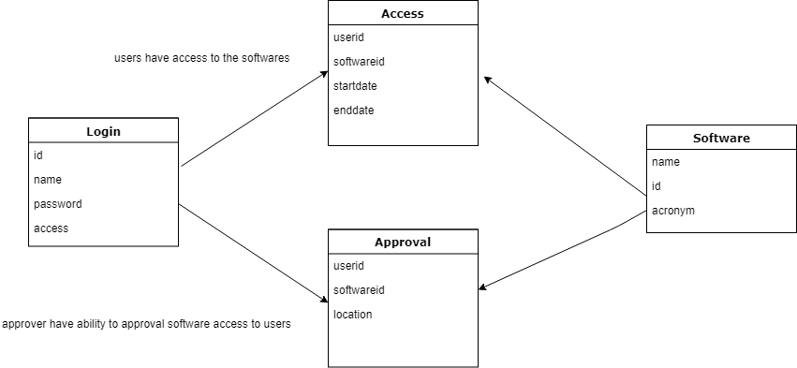

Slide 4
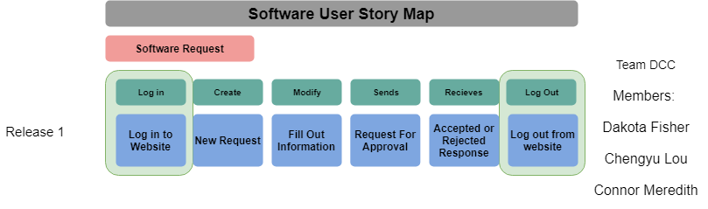

Slide 5
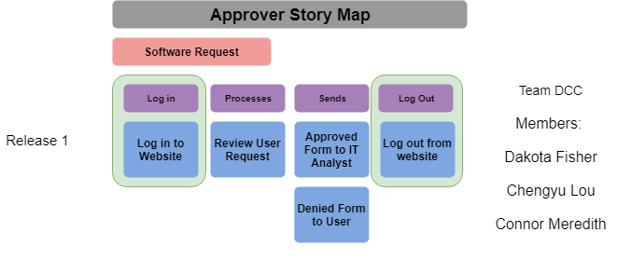

Slide 6
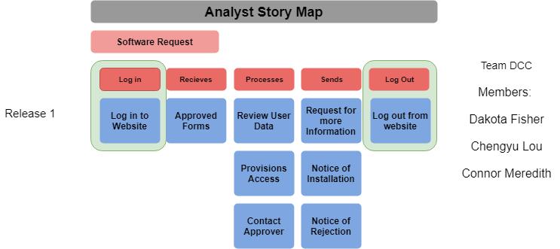

Slide 7
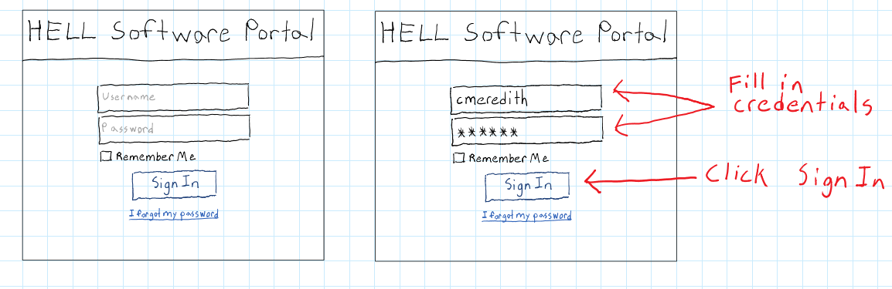
Sign in page (All Users)

Slide 8
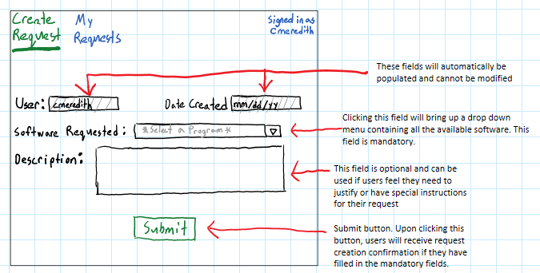
Create Request page (General Users)

Slide 9
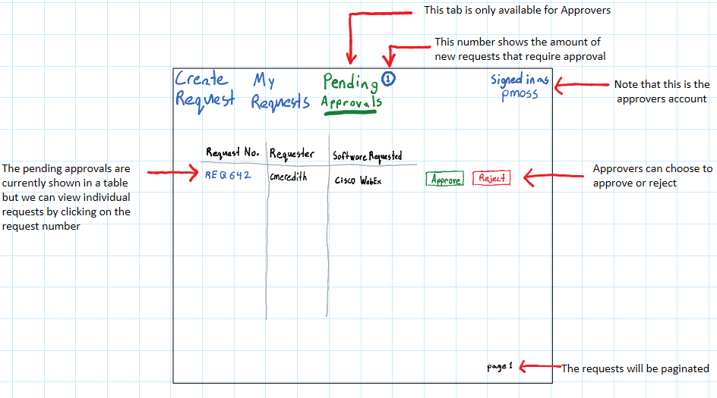
Pending Approvals (Approvers)

Slide 10
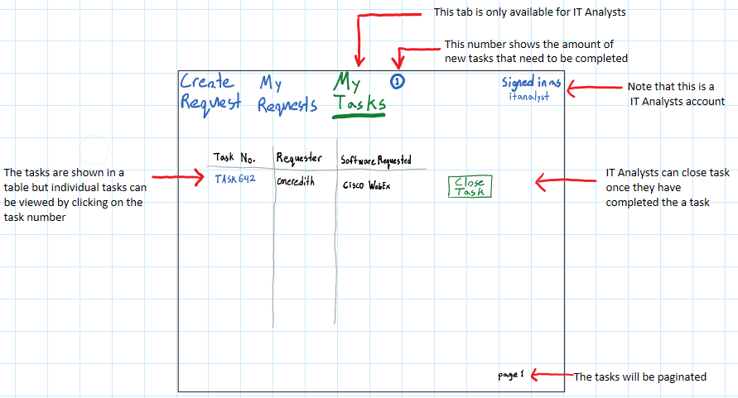
My Tasks (IT Analysts)

Slide 11
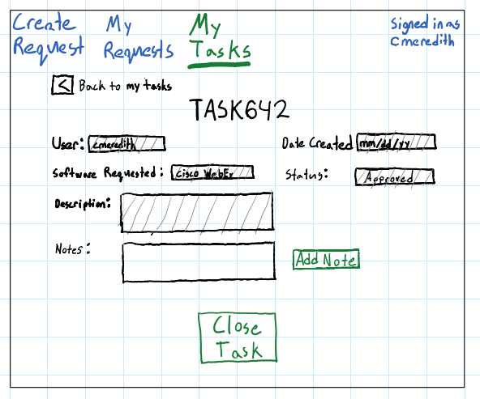
Viewing individual tasks (IT Analysts & Approvers)

Slide 12
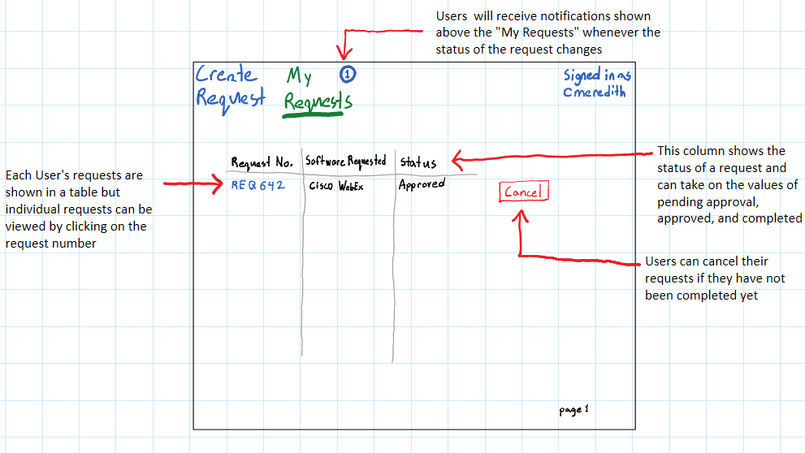
My Requests (All Users)

Slide 13
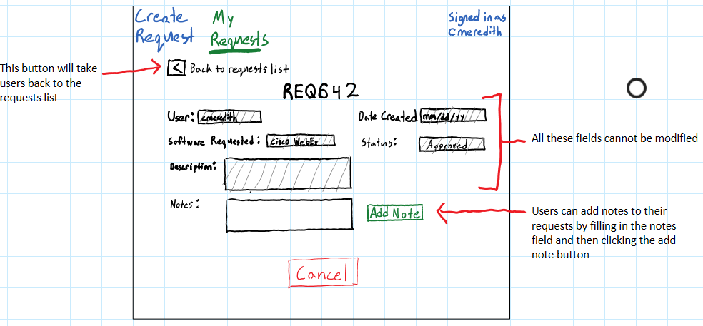
Viewing Individual Requests (All Users)

Slide 14
Our experience with low fidelity prototypes
We used Microsoft OneNote to make our prototypes
Pros
Quick and easy
Very little commitment required for each prototype (enables flexibility)
Cons
Drawing prototypes by hand is not the most neat
Handwritten labels can be difficult to read and size appropriately

Slide 15
Changes & Misc.
Have your plans changed since your group’s initial conception and project evolution
Through feedback and observations, we’ve added a login system to control and enforce more regulated data.
The question arose, does a software user need to log in to request a software?
We decided that they should , as it is a corporation, and it increases data integrity, as well as requires just as much form data to be entered on the software user’s end.
We’re still aligned with our FSM, it’s a clean path to follow.

Slide 16
Group reflection
How did you feel about this milestone? What did you like about it? What did you dislike?
It’s a great way to start to envision the product, before completely dedicating resources to the design.
No dislikes in particular, it’s a good milestone.
What did you learn about yourself as you collaborated and worked through this milestone?
It’s important to be efficient with time, to reduce the stress on everyone in the group.
It’s okay to ask for help.

Slide 17
Group reflection
How will you use what you have learned going forward?
The Lo-Fi model is a solid foundation for rapid design development, and easily adjustable.
What “stuff & things” related to this milestone would you want help with?
One Challenge we ran into, was the lack of a formal definition of what data is required from the form for the Analysts.
currently, description is a placeholder for additional detailed information and the user’s reason for the request.

Slide 18
Low Fidelity prototypes for all users perspectives
These slides will not be covered in our presentation
They are just intended for anyone seeking more details about our design
These slides show all the pages in our app for every type of user (general user, approver, IT analyst, and IT analyst & approver)

Slide 19
Sign in page (All Users)

Slide 20
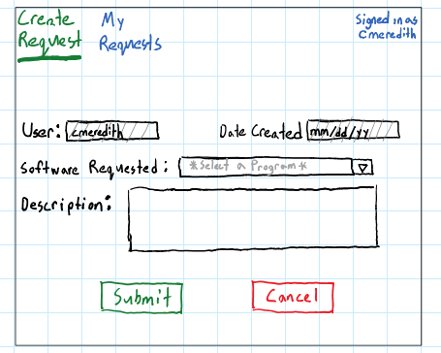
Create Request (General User)

Slide 21
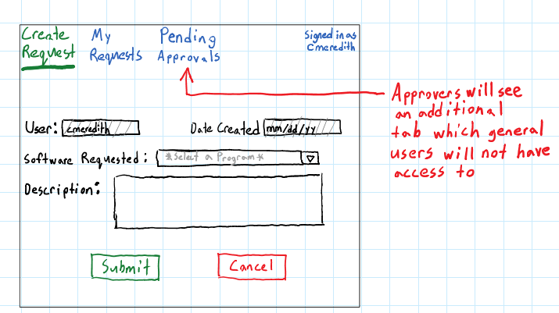
Create Request page (Approver)

Slide 22
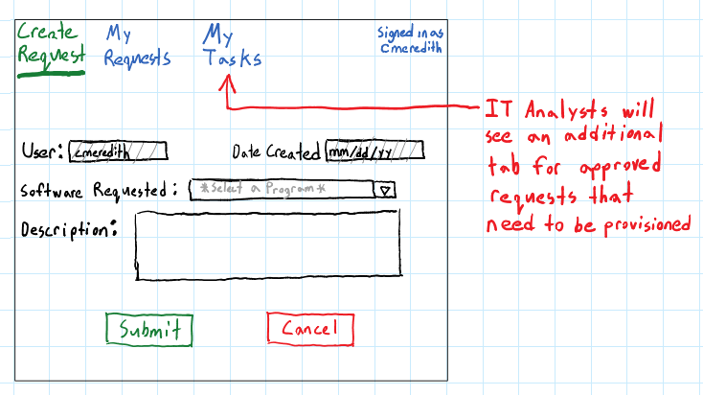
Create Request page (IT Analyst)

Slide 23
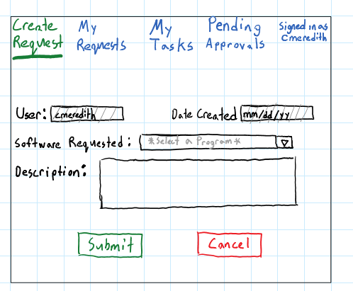
Create Request page (IT Analyst & Approver)
This subset of users will have two additional tabs. One for their role as an approver and one for their role as an IT analyst

Slide 24
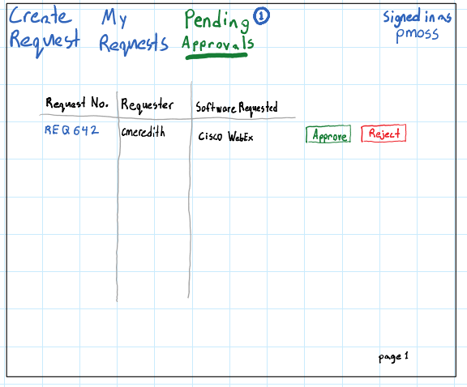
Pending Approvals (Approver)

Slide 25
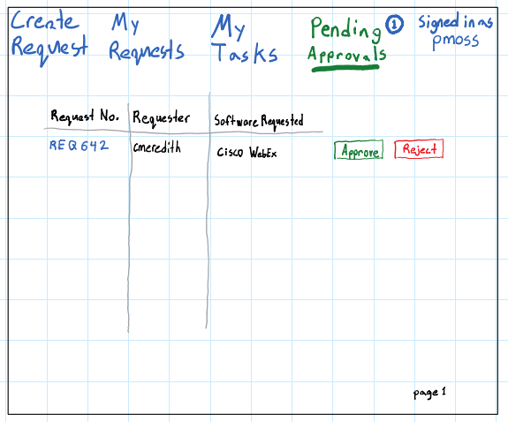
Pending Approvals (IT Analyst & Approver)

Slide 26
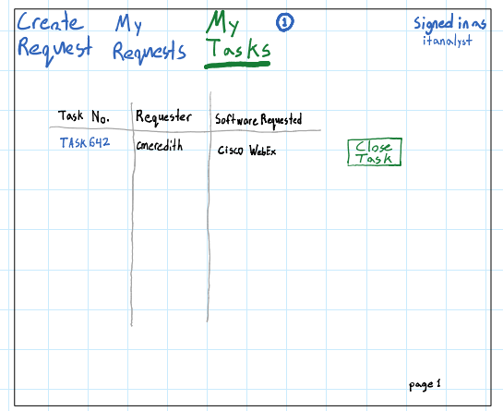
My Tasks (IT Analyst)

Slide 27
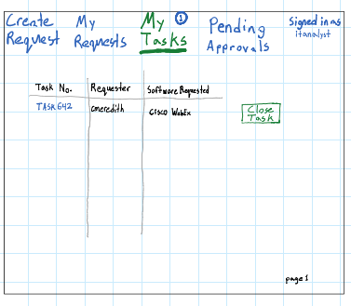
My Tasks (IT Analyst & Approver)
To view individual tasks containing more detail click the task number
In this case users could click “ TASK642”

Slide 28
Viewing individual tasks (IT Analysts & Approvers)

Slide 29
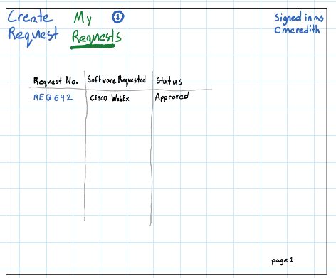
My Requests (All users)
To view individual requests containing more detail click the request number
In this case users could click “ REQ642”

Slide 30
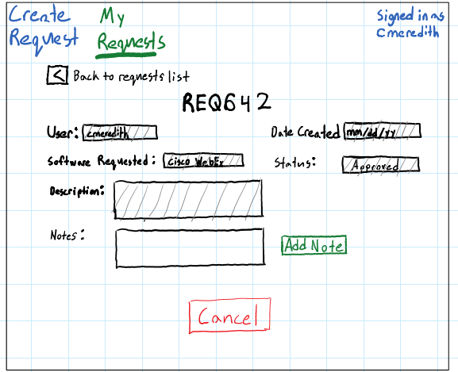
Viewing individual requests (All users)

